Slide 1

Addressing COVID-19: Overcoming Vaccination
Hesitancy
Webinar Series
April 21, 2021

Slide 2

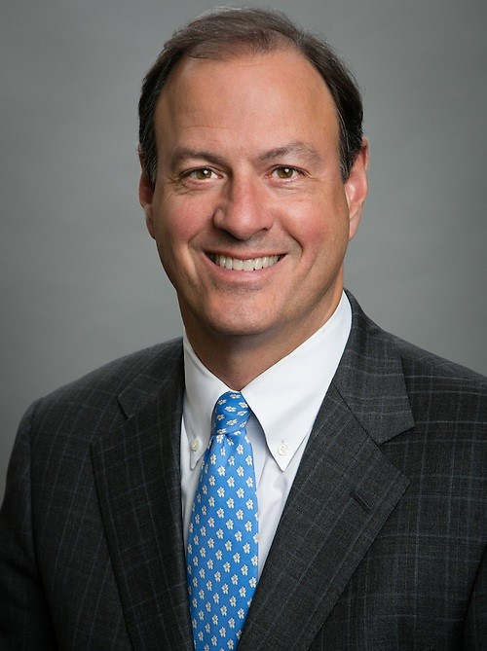
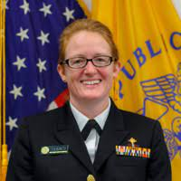
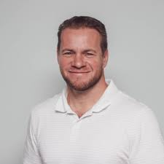
Panelists
CDR Alice Shumate
Director – NIOSH Center for Maritime Safety and Health Studies
Dr. Scott Cherry
Chief Medical Officer
Axiom Medical
Mr. Merritt Lane
President & CEO – Canal Barge Company

Slide 3
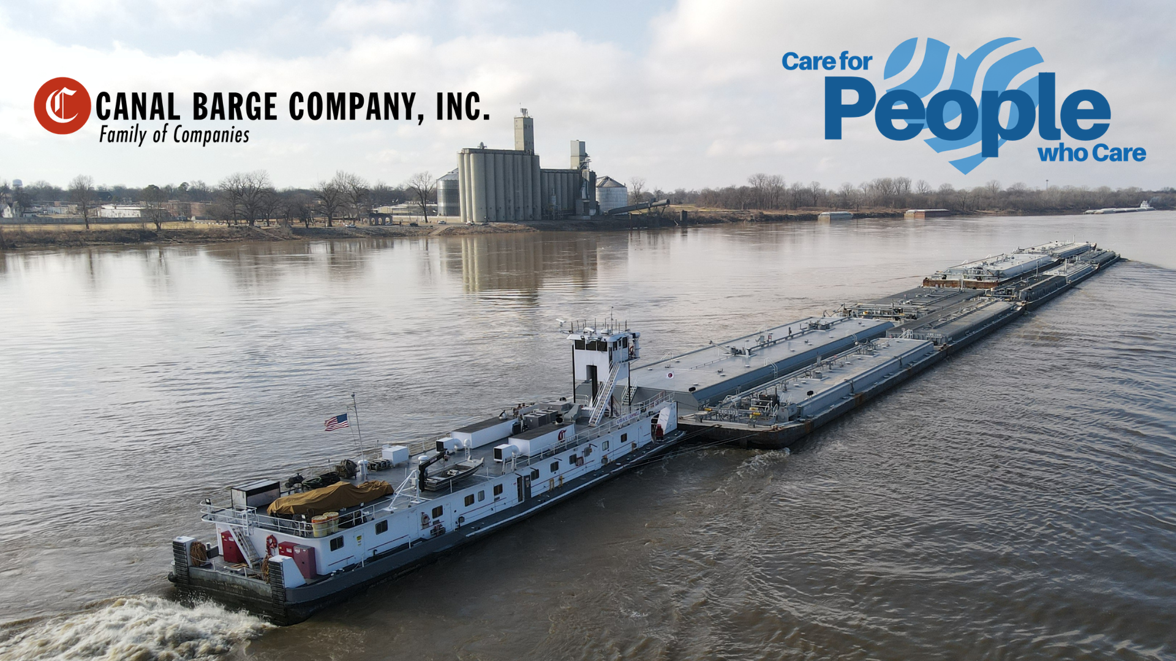
AWO Webinar
Addressing COVID-19: Overcoming Vaccine Hesitancy

Slide 4
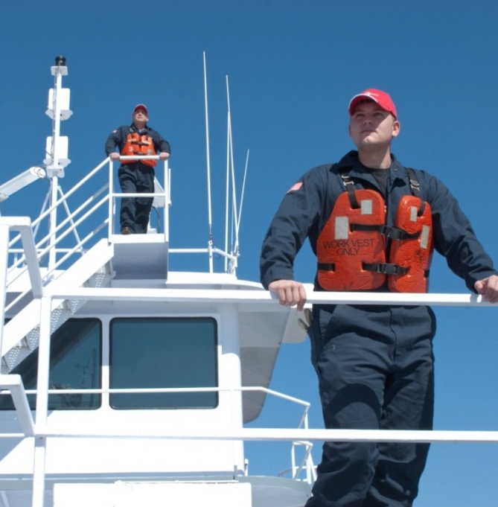

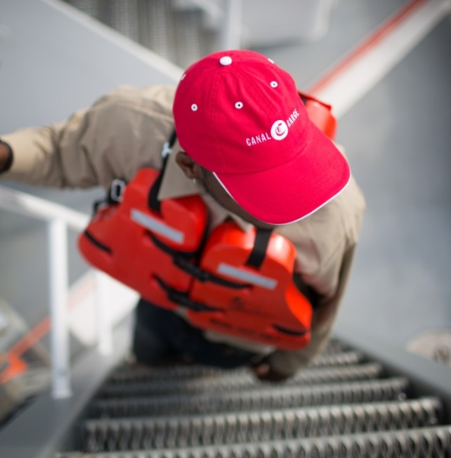
Canal Barge Company, Inc.
One of the largest and most diverse privately-owned marine transportation companies in the U.S.
  We operate 50 towboats and 950 barges.
  We have about 900 employees and operate all over the inland waterway system.
Notes:
4
CBC was founded in 1933 with 1 tank barge, the CBC-1. The name ‘Canal Barge’ comes from the area of operation in the early years when we primarily moved gasoline along the canal system in New Orleans. As we have grown, we continue to focus on areas that our people can truly make a difference.

Slide 5
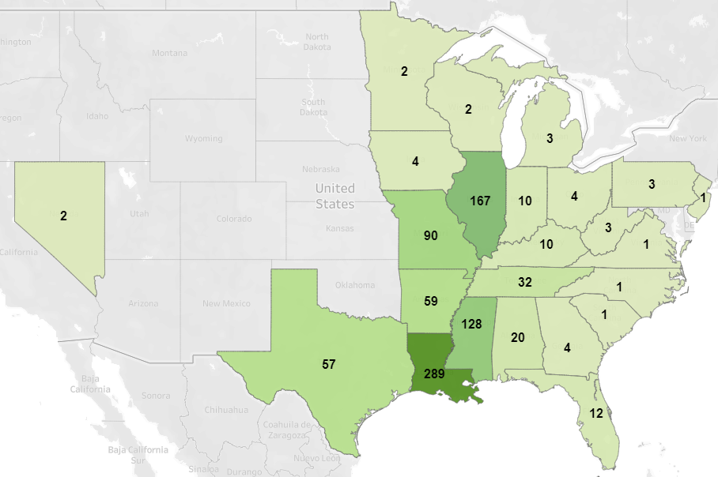
CBC People – Where We Live
June 2018

Slide 6

Unique Challenges
Essential to the national economy – 24-7-365 cadence – we literally never close.
Distance from mariners.
Many states and jurisdictions – nothing is uniform.
Crew change cadence and close quarters –minimize “vectors” and create “citadels”.
Backdrop of mistrust of information sources and “experts”.

Slide 7
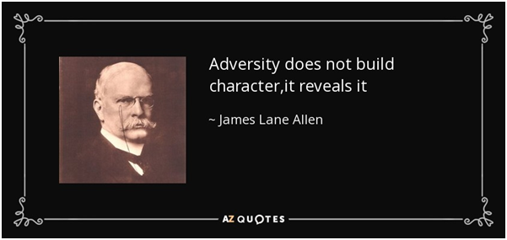
You Can’t Create A Healthy Culture
After the Crisis

Slide 8
Play to Your Strengths:
CBC Advantages
Trusting relationships – we know our people – many long-tenured employees.
Safety and Wellness culture. Experienced risk managers.
Culture of fact-based management.
We work hard to stay connected and communicative all of the time – not just in crisis.
Our approach to COVID has been consistent with our prior practice – relied on our “high trust’ culture to enable us to have a high degree of transparency and open 2-way communication.

Slide 9
Focused on Risk Management:
Experience and Tools
As a New Orleans-based company who moves liquid cargoes, we have “real world” risk and crisis management experience and tools:
  Emergency Response Plan → Business Continuity Plan.
  Hurricane Plan → Katrina Lessons Learned.
  Vessel Security Plans → Access and boarding protocols.
  Incident Command System → staple of CBC operational training with some “real world” experience.

Slide 10
CBC’s Approach to COVID
Be Proactive and Get Organized!
Be prepared for a sustained effort and be a “felt” leader.
  Stood up Business Continuity team in late JANUARY 2020!
    Started as a drill and morphed into daily and then 2 times per week meetings.
  Additional Resources – Company Doctor, Ochsner, TUSPH
  Built on existing communication channels and added more through technology
    Focused on direct communication from the CEO through regular town hall and smaller sessions via Zoom.

Slide 11
CBC and COVID-19 Messaging
We are all in this together!
  Our jobs are essential to the nation.
  We must protect our people and preserve business continuity.
Shared responsibilities:
  Care for People/People Who Care.
  COVID Goal: No one gets sick at work. We fight the spread through science- informed, disciplined operations and behaviors.
  We plan to emerge as a stronger, more trusting organization post-COVID.

Slide 12
CBC’s Approach to Vaccine Rollout
Adopted the ICS to manage the vaccine rollout.
  Appointed Incident Commander reporting to the CEO to lead the effort.
Strategy:
  Fact based decisions based on science and data.
  Communicate using all channels and opportunities
  Be open and approachable
Encourage personal responsibility but assist where necessary.

Slide 13
CBC’s Vaccine Rollout
Goal: Keep People Safe & Company Operating by Encouraging Vaccination
Objective: provide best available information for our people to make the decision.
Tactics: Meet our people where they are – Personal calls, meetings, videos from teammates, FAQs – understand concerns and needs.
Statistics: Self-reported census of most employees.
Leadership: Make informed decisions and help CBC meet our goals.
Logistics: Assist with logistics as appropriate while encouraging individual initiative. Create mass vaccination opportunities.

Slide 14
CBC Vaccine Rollout –
FAQs and Response
Nature of questions:
Speed of development & approval.
Efficacy and side effects.
Logistics.
Resistance seems to come from fear, indifference, political beliefs and is fed by misinformation.
We responded with:
Trusted sources of good information in easy to digest forms.
Sharing data and personal experiences.
Creating norms among work groups.
Considering the impact of not vaccinating –providing incentives.
J&J pause
Creates an additional problem – both logistics and possible increased concerns re. vaccination….
We have increased information sharing regarding Pfizer and Moderna while continuing to gather and share information about J&J.
Encouraging people to speak to their personal physician.

Slide 15
Transparency and Fact-based Decision Making
In crisis management, be quick with the facts, slow with the blame.
– Leonard Saffir

Slide 16
COVID-19 Vaccine Implementation

Slide 17
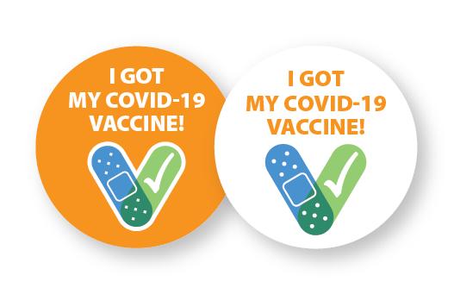
Currently Authorized Vaccines
Pfizer-BioNTech
Moderna
Johnson & Johnson/Janssen
All three vaccines were tested in tens of thousands of adults from diverse backgrounds, including older adults and communities of color.
All of the available vaccines have been proven effective at preventing serious illness, hospitalization, and death from COVID-19 disease.
It is unknown how long protection from vaccines might last.
mRNA vaccine
Require two doses
Viral vector vaccine
Requires one dose
https://www.pfizer.com/news/press-release/press-release-detail/pfizer-and-biontech-conclude-phase-3-study-covid-19-vaccine
https://investors.modernatx.com/news-releases/news-release-details/modernas-covid-19-vaccine-candidate-meets-its-primary-efficacy
4/21/2021

Slide 18
What are messenger RNA (mRNA) vaccines?
Carry genetic material that teaches our cells how to make a harmless piece of “spike protein,” which is found on the surface of the SARS-CoV-2 virus.
  Genetic material from the vaccine is destroyed by our cells once copies of the spike protein are made and it is no longer needed.
Cells display this piece of spike protein on their surface, and an immune response is triggered inside our bodies. This produces antibodies to protect us from getting infected if the SARS-CoV-2 virus enters our bodies.
Sources: College of Physicians of Philadelphia. What is an mRNA vaccine? https://historyofvaccines.blog/2020/07/29/what-is-an-mrna-vaccine/
JAMA. COVID-19 and mRNA Vaccines—First Large Test for a New Approach. https://jamanetwork.com/journals/jama/fullarticle/2770485
4/21/2021

Slide 19
COVID-19 Vaccines
Like all vaccines, COVID-19 vaccines have been rigorously tested for safety before being authorized for use in the United States.
The vaccine technology has been well studied for decades.
COVID-19 vaccines do not carry a risk of causing disease in the vaccinated person.
The genetic material delivered by the COVID-19 vaccines does not affect or interact with a person’s DNA.
4/21/2021

Slide 20
Fast-Tracking COVID-19 Vaccines While Ensuring Safety
COVID-19 vaccines were developed based on years of research.
Researchers used existing networks to conduct COVID-19 vaccine trials.
Manufacturing began while clinical trials were still underway. Normally, manufacturing doesn’t begin until after trials are completed.
FDA and CDC are prioritizing review and authorization of COVID-19 vaccines.
*For more information, visit the COVID-19 Prevention Network: www.coronaviruspreventionnetwork.org/about-covpn
4/21/2021

Slide 21



COVID-19 and Vaccine Basics
Safety of COVID-19 Vaccines Is a Top Priority
COVID-19 vaccines are being held to the same safety standards as all vaccines.
Before Authorization
After Authorization
FDA carefully reviews all safety data from clinical trials.
ACIP reviews all safety data before recommending use.
FDA and CDC closely monitor vaccine safety and side effects. There are systems in place that allow CDC and FDA to watch for safety issues.
v-safe: https://www.cdc.gov/coronavirus/2019-ncov/vaccines/safety/vsafe.html
4/21/2021

Slide 22



Active Safety Monitoring for COVID-19 Vaccines
V-safe is a new CDC smartphone-based monitoring program for COVID-19 vaccine safety:
  Uses text messaging and web surveys to check in with vaccine recipients after vaccination.
  Participants can report any side effects or health problems after COVID-19 vaccination.
  Includes active telephone follow-up by CDC for reports of significant health impact.
4/21/2021

Slide 23

COVID-19 Vaccination is a Safer Way to Build Protection
Getting the virus that causes COVID-19 may offer some natural protection, known as an antibody or immunity. But experts don’t know how long this protection lasts.
The risk of severe illness and death from COVID-19 far outweighs any benefits of natural immunity.
COVID-19 vaccination will help protect you by building immunity without the risk of severe illness.
4/21/2021

Slide 24




Key Facts about COVID-19 Vaccination
Getting vaccinated can help prevent you from getting sick with COVID-19
People who have already gotten sick with COVID-19 may still benefit from getting vaccinated
COVID-19 vaccines cannot give you COVID-19
COVID-19 vaccines will not cause you to test positive on COVID-19 viral tests*
https://www.cdc.gov/coronavirus/2019-ncov/vaccines/about-vaccines/vaccine-myths.html
*https://www.cdc.gov/coronavirus/2019-ncov/hcp/testing-overview.html
4/21/2021

Slide 25

What to Expect Before, During, and After COVID-19 Vaccination
Before
  Learn about COVID-19 vaccines.
  See if COVID-19 vaccination is recommended for you.
During
  Read the fact sheet that tells you about the specific COVID-19 vaccine you receive.
  Receive a vaccination record card.
After
  Expect some
  side effects.
  Enroll in v-safe.
  Continue using all
  the measures to protect yourself and others.
V-safe: https://www.cdc.gov/coronavirus/2019-ncov/vaccines/safety/vsafe.html
4/21/2021

Slide 26

Protect Yourself, Your Family, Your Friends, Your
Co-workers, and Your Community.
Get vaccinated.
Choose to get vaccinated when it is offered.
Participate in v-safe and help CDC monitor for any health effects after vaccination.
Share your experience with coworkers, friends, and family.
Know the basics about the COVID-19 vaccine. Help answer questions from your family and friends.
Show you received the vaccine by wearing a sticker
or button prominently.
4/21/2021

Slide 27
Transportation Workers and COVID-19 Vaccination
Multiple worker groups: public transit, aviation, trucking, maritime, and postal workers
Important considerations for vaccination of workers:
  Ability to obtain two doses in same location (for certain vaccines only)
  Ability to get vaccine outside their state of residence
  Some subgroups (for example, truck drivers) face high prevalence of chronic health conditions
  Concern about post-vaccine symptoms “on the road”
    Possible solutions: get one-dose vaccine, partner with key truck stops/companies, and have local health departments administer vaccines
4/21/2021

Slide 28
Workplace Vaccination Program
Employers considering implementing a workplace COVID-19 vaccination program should:
Contact the health department in their jurisdiction for guidance.
Understand a workplace vaccination program works best for employers with:
  A large number of workers on site with predictable schedules
  A location with enough space to stand up a vaccination clinic while maintaining social distancing through the process
Include input from management, human resources, employees, and labor representatives in the planning process.
Offer the vaccination at no charge to workers and offer it during work hours.
Offer more than one opportunity for vaccination. Workers who are hesitant at first might become more confident after seeing coworkers get vaccinated.
Offer flexible, non-punitive sick leave options for employees with signs and symptoms after vaccination.
https://www.cdc.gov/coronavirus/2019-ncov/vaccines/recommendations/essentialworker/workplace-vaccination-program.html
https://www.eeoc.gov/wysk/what-you-should-know-about-covid-19-and-ada-rehabilitation-act-and-other-eeo-laws
4/21/2021

Slide 29
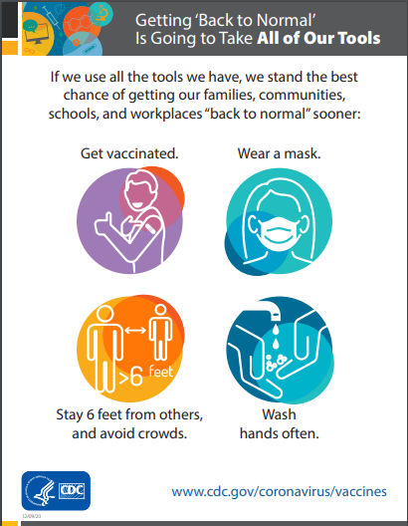
Encourage Employees to Get Vaccinated
If your business can’t offer COVID-19 vaccinations on site, encourage employees to seek COVID-19 vaccination in their community and provide them with information about where they can get the vaccine.
  Be flexible in your human resources policies. Establish policies that allow employees to take paid leave to seek COVID-19 vaccination in the community. Support transportation to off-site vaccination clinics.
  Use promotional posters/flyers to advertise locations offering COVID-19 vaccination in the community. Display posters about COVID-19 vaccination in break rooms, cafeterias, and other high traffic areas.
  Post articles in company communications (e.g., newsletters, intranet, emails, portals) about the importance of COVID-19 vaccination and where to get the vaccine in the community.
https://www.cdc.gov/coronavirus/2019-ncov/vaccines/recommendations/essentialworker/workplace-vaccination-program.html
4/21/2021

Slide 30



COVID-19 Vaccine Communication Toolkit for Essential Workers
This toolkit will help your organization educate community members about COVID-19 vaccines, raise awareness about the benefits of vaccination, and address common questions and concerns.
Key messages
Slide deck
Frequently Asked Questions
Posters/Flyers
Newsletter Content
Letter to Members
Social Media Content
https://www.cdc.gov/coronavirus/2019-ncov/vaccines/toolkits/essential-workers.html
4/21/2021

Slide 31
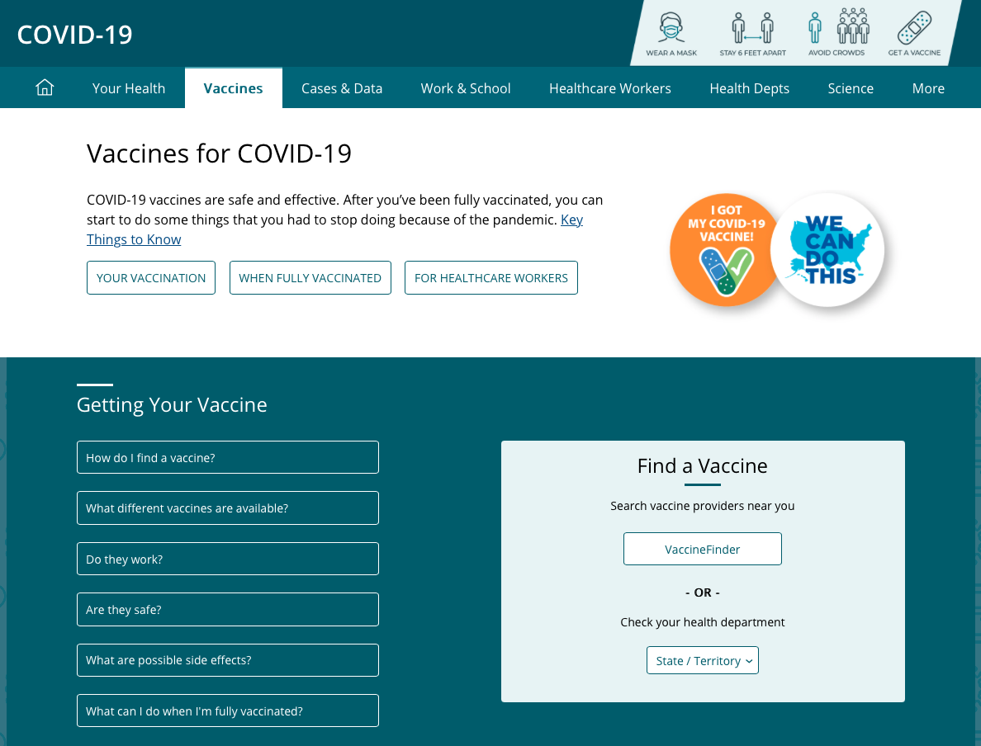
COVID-19 and Vaccine Basics
Where Can You Get More Information?
  https://www.cdc.gov/coronavirus/2019-ncov/vaccines/index.html
4/21/2021

Slide 32

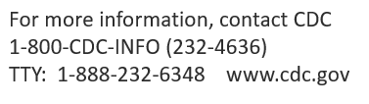
Thank you
4/21/2021

Slide 33


Dr. Scott Cherry
DO, MPH, FACOEM
Chief Medical Officer
AXIOMMEDICAL

Slide 34






COVID-19 POLICY DEVELOPMENT LEGAL/PRACTICAL CONSIDERATIONS
LIABILITY
PRACTICAL
Vaccine Authorized Under Emergency Use Act vs. Full FDA Approval
Timing/Rollout
Vaccine Injury Compensation Program (Medical Risk)
Side Effects
Goals of Vaccination Program (Infection vs. Severe Disease Prevention
Employment Law Risk?
Unintended Consequences

Slide 35



Risk Assessment Business Necessity
EMPLOYEE
VACCINATION
MANDATES
Multi-Stakeholder Approach
(HR, Legal, Risk, Safety, Medical)
Americans with Disabilities Act (ADA) Considerations
  Medical Contraindications May be Considered Disabled
  ADA Violations if Accommodation
  is Not Available
  Religious Exceptions

Slide 36
REDUCING COVID-19 TRANSMISSION RISK
SAFETY AND SECURITY IN A
COMPREHENSIVE LAYERED APPROACH
Testing
Vaccination
Hand Hygiene
Isolation/Contact Tracing
Daily Attestations of Health
Personal Protective Equipment
Contagious Respiratory Illness Assessment
Environmental Cleaning and Safety Controls

Slide 37

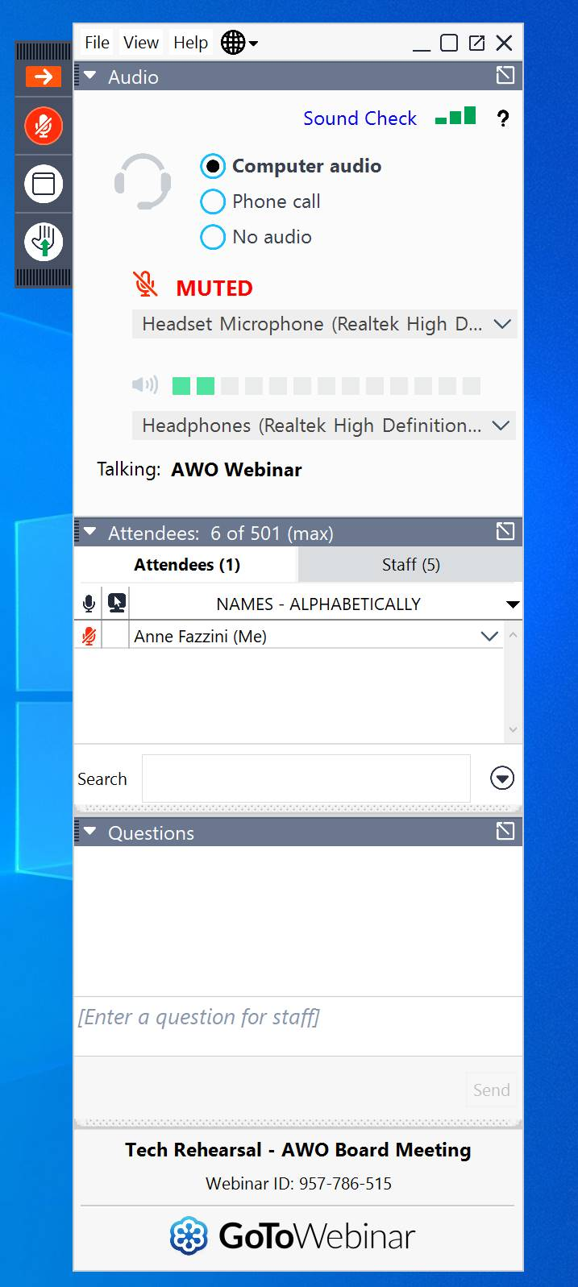
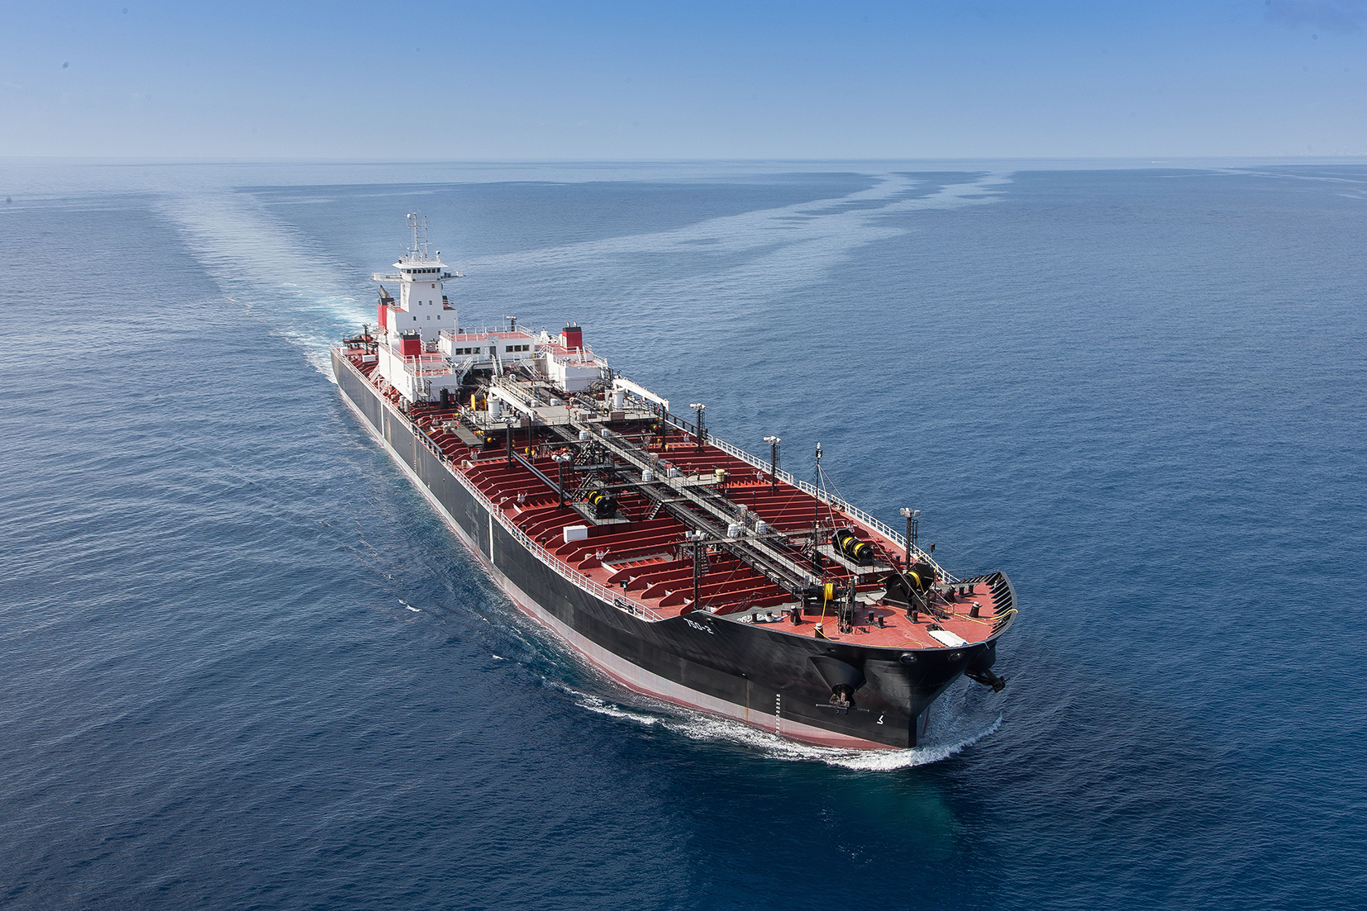
Q&A Session
Window Mode/ Full Screen Mode
Question/
Chat Box

Slide 38
Thank You!
americanwaterways.com/covid19
safety@americanwaterways.com

